Slide 1
Terra Education and Communications
An Overview and Call for Participation
Tassia Owen, Terra EPO Lead, Sigma Space
Tassia.owen@nasa.gov

Slide 2
Overview
1. Terra Website launch and Redesign
2. Terra at 15 and Earth Right Now
3. Terra at AGU
4.Terra Outreach Highlights
5. Call for Volunteers

Slide 3
Terra Website Redesign

Slide 4
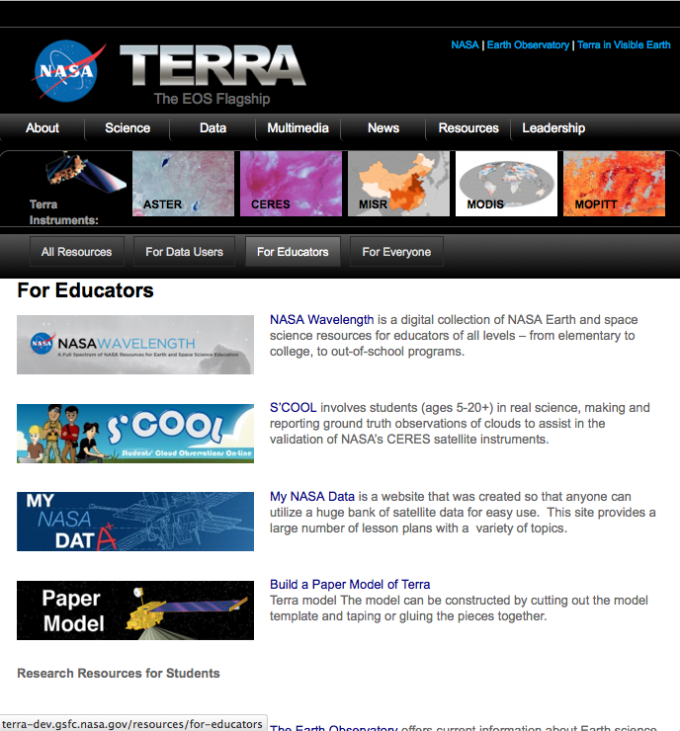
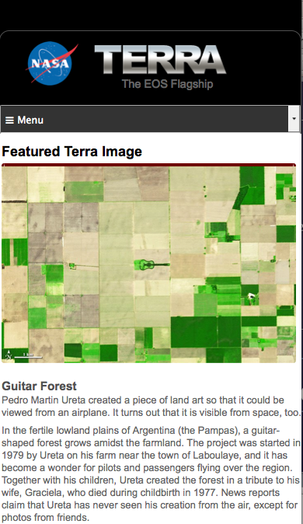
Tablet and Mobile Formats

Slide 5
New Features: Mobile and Tablet Friendly
On May 23, 2012, the President issued a directive entitled “Building a 21st Century Digital Government”. It launched a comprehensive Digital Government Strategy aimed at delivering better digital services to the American people. The strategy builds on several initiatives, including Executive Order 13571, Streamlining Service Delivery and Improving Customer Service, and Executive Order 13576, Delivering an Efficient, Effective, and Accountable Government.
The strategy lays out actions in a 12-month roadmap and has three main objectives:
Enable the American people and an increasingly mobile workforce to access high-quality digital government information and services anywhere, anytime, on any device.
Ensure that as the government adjusts to this new digital world, we seize the opportunity to procure and manage devices, applications, and data in smart, secure and affordable ways.
Unlock the power of government data to spur innovation across our Nation and improve the quality of services for the American people.
Source: http://www.whitehouse.gov/digitalgov/about

Slide 6
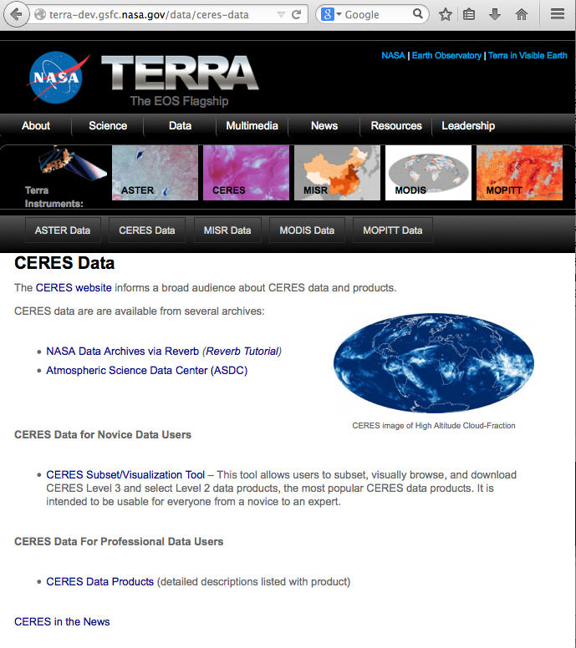
Improved Data Sections
Highlights:
Simpler design
Directs Users to resources
Gives options for different levels of users
Links to stories in the news about sensor/data

Slide 7
Better Access to Resources

Slide 8
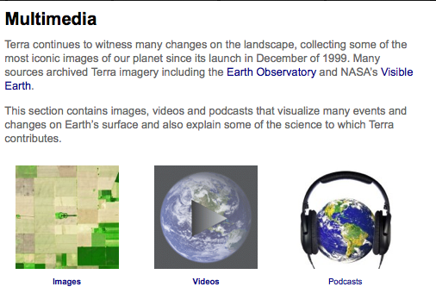
Streamlined Access to Multimedia Options

Slide 9
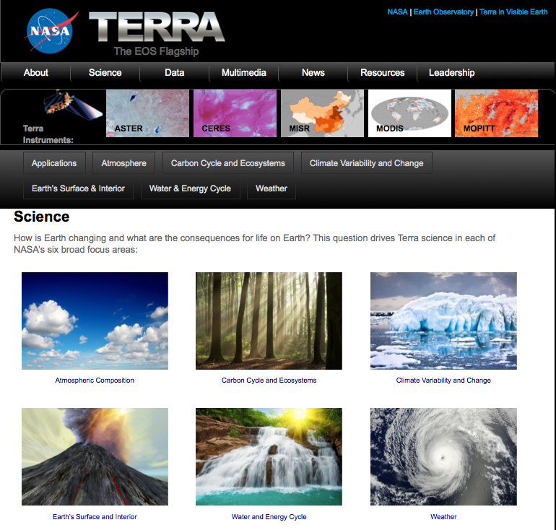
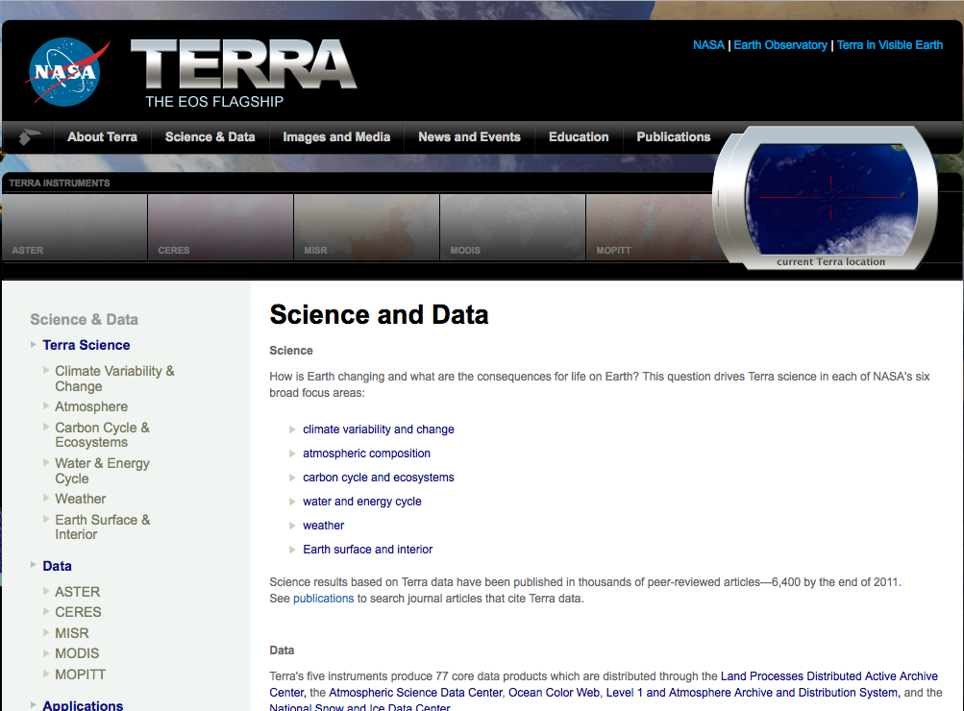
Streamlined Design
Old vs. New

Slide 10
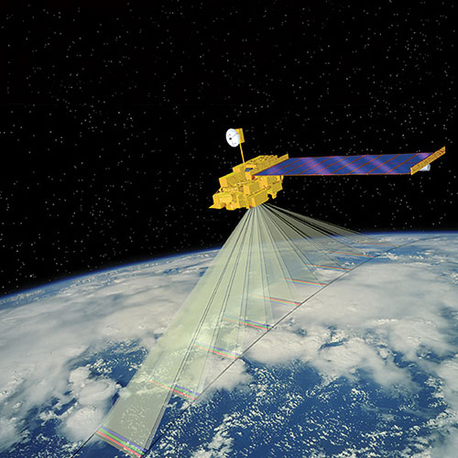
Website Summary
Improvements:
Mobile and Tablet Friendly
Improved Data Sections
Better Access to Resources
Streamlined Access to Multimedia Options
Simplified Design

Slide 11
Terra at 15 and Earth Right Now
A Big Year for NASA Earth Science
5 satellites in 2014
Earth Science is NASA’s theme for 2014
Terra at 15: Looking back at 15 years of EOS – Capstone message for 2014
December is all about Terra and EOS

Slide 12
Terra at 15 events
AGU special session
Articles in Earth Observer and Earth Observatory
Office of Communications will release other media
Small gathering with speakers and cake at GSFC
Event in conjunction with Earth Day at GSFC Visitor Center

Slide 13
Your Help is Needed: Please suggest ideas for articles
Need help identifying:
significance of 15 years of EOS data
examples of a science result or question that involves multiple systems, the cryosphere, atmosphere, and hydrosphere

Slide 14
Terra at AGU
Volunteers needed to present at NASA booth at AGU
dynamic suite of talks and activities at side booth
Hyperwall presentations
If interested, please contact tassia.owen@nasa.gov

Slide 15
AGU – Side Booth Presentations
Talk Title and Abstract – Short catchy title and 200 word or less abstract. Please spell out acronyms.
Description of the tool or science talk that focuses on the big picture message, and draws out the “value-added” benefits, interesting or key science results, and for tools the key tool features, functions and/or capabilities.
Speaker name and professional title along with any relevant urls.

Slide 16
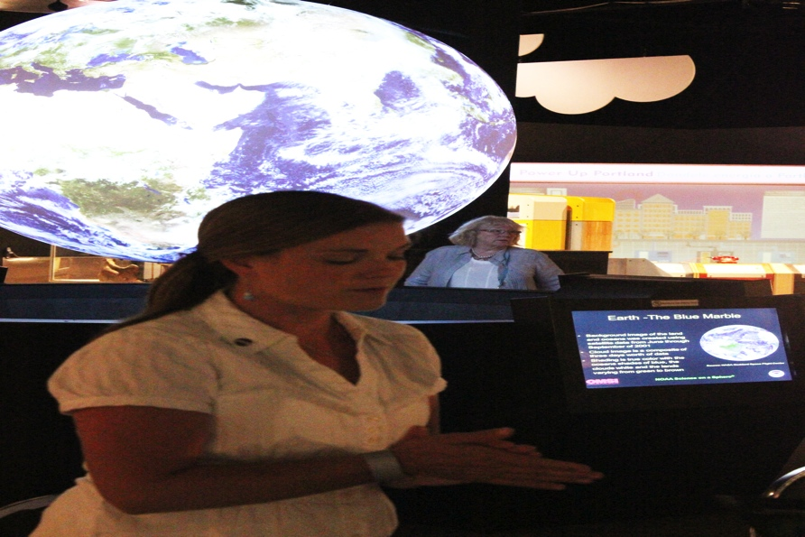
Terra Outreach Highlights
Know Your Earth: Quizzes - monthly
OMSI After Dark – 1,800 attendees
ReelScience Communication Contest – 42 Youth Entries, 3 winners, 2 Terra videos
“Demos in a Box” – in progress
Notes:
The people are happy with milking the length of the mission. Even if others aren’t giving you all kudos. “The people” are impressed.

Slide 17
Know Your Earth 2014
Current Quizzes:
Carbon
Precipitation and the Water Cycle
The Frozen Poles
Our Home Planet
The Air we Breathe
http://www.nasa.gov/KnowYourEarth

Slide 18
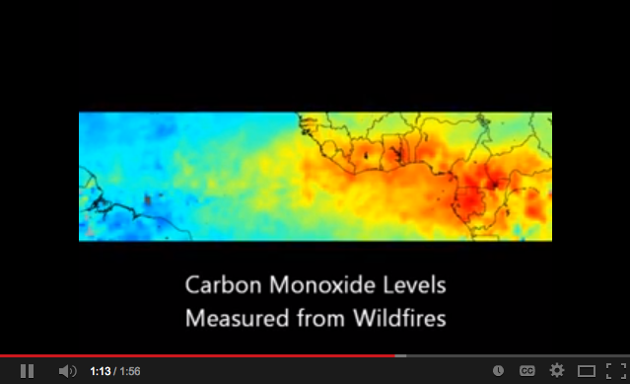
ReelScience Communcation Contest
http://youtu.be/LIKMQQ5EuUA

Slide 19
ReelScience Communication Contest
http://youtu.be/cAMcp0pk0Rw
Notes:
http://youtu.be/cAMcp0pk0Rw

Slide 20
We Need You!
AGU hyperwall and side booth presenters
Speakers for science talks
Provide stories and imagery for news on a rotating schedule – starting with MODIS, ASTER, MISR, MOPITT and then CERES schedule will begin in October

Slide 21
Thank You!
Questions?
tassia.owen@nasa.gov

