Slide 1
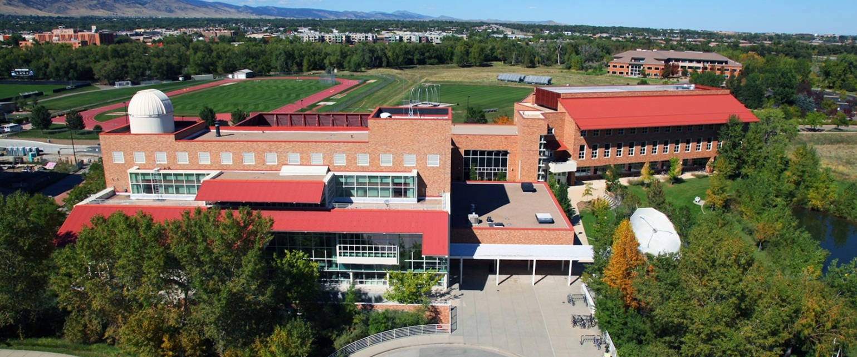
Laboratory for Atmospheric and Space Physics (LASP) A Research Institute of the University of Colorado
More than sixty years of space science research since the laboratory’s inception as the Upper Air Laboratory in 1948
Planetary Science • Space Physics • Solar Influences • Atmospheric Science • Engineering • Mission Operations & Data Systems
http://lasp.colorado.edu
Notes:
1

Slide 2
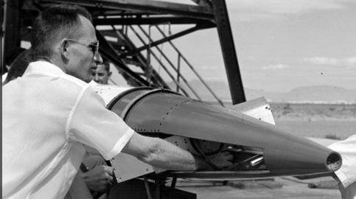
The Rich History of LASP
1948 Began as the Upper Air Laboratory (UAL) by CU physicists interested in using rockets to study the Earth’s atmosphere
1950s Solar rocket engineers spun off to form
Ball Aerospace. LASP continues to partner
with Ball on space missions
1958 Began flying instruments on NASA’s solar-
observing rockets when the government
formed NASA
Became LASP and expanded into solar-observing spacecraft, earth/atmospheric satellites, and space and planetary sciences (Mariner spacecraft)
1980s Flew instruments on space shuttles and trained LASP’s first team of students to operate spacecraft on the Solar Mesosphere Explorer (SME)
2003 Launched SORCE, demonstrating LASP’s ability to manage large PI-Led missions. More than $85M to LASP included science, engineering development, calibration, testing, spacecraft procurement, integration, and operation of all four solar-observing instruments and the spacecraft.
2013 LASP’s Remote Sensing (RS) instrument, and collaborated LPW instrumentation, launched on MAVEN
(Mars Atmosphere and Volatile Evolution Mission). Scientists and the MAVEN PI, LASP’s Bruce
Jakosky, will use MAVEN data to explore the loss of volatile compounds—such as CO₂, N₂, and
H₂O—from the Martian atmosphere to space.
65 Years
Image courtesy LASP UAL

Slide 3
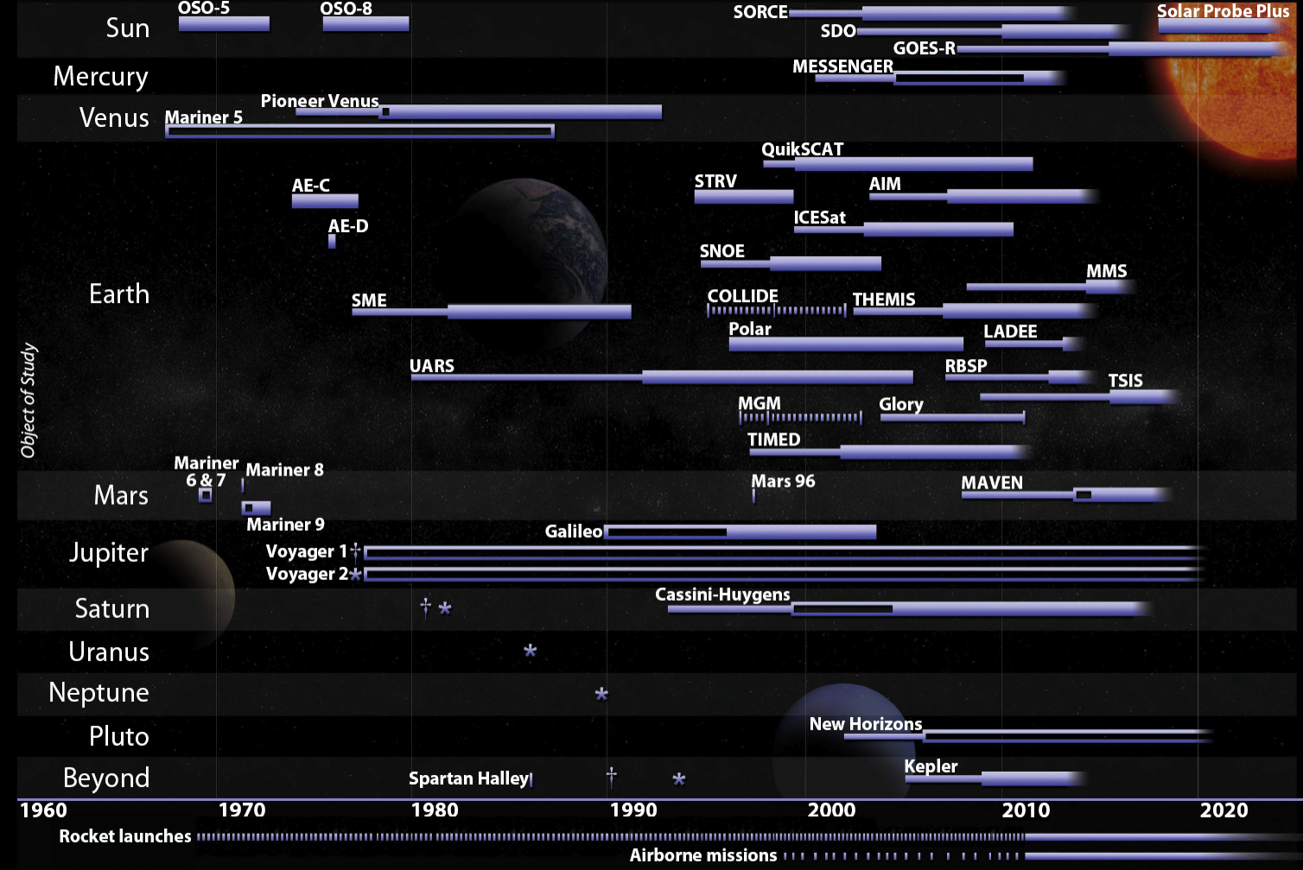
LASP Space Mission Participation
LASP has now sent instruments to every planet in the solar system, Pluto, and beyond (Voyager)

Slide 4
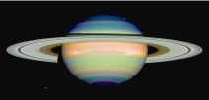
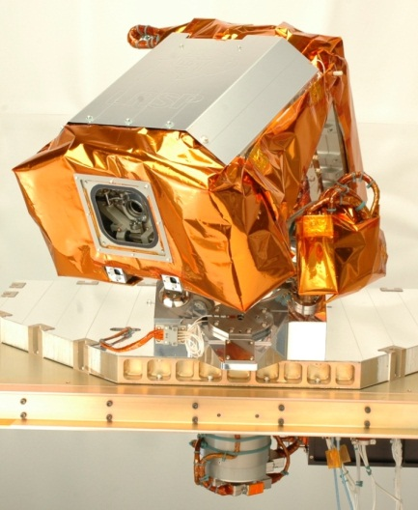
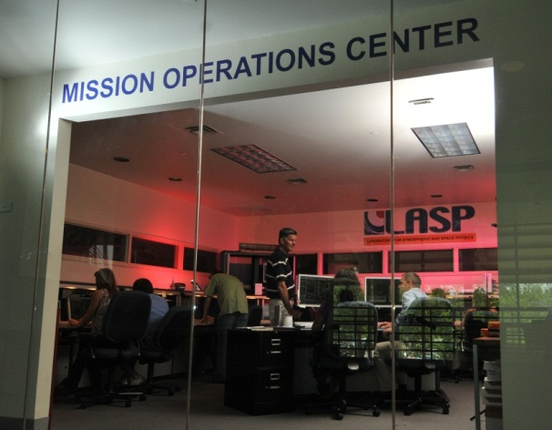
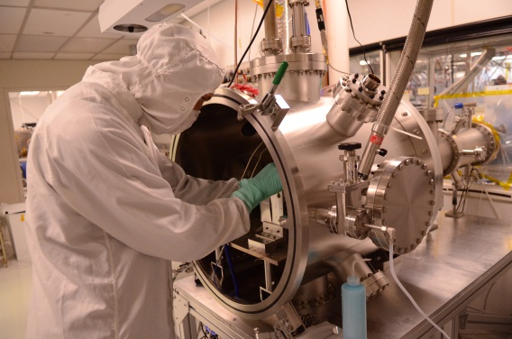
Doing it all: Formulate, design, build, test and operate
Scientists Study Data, Publish Discoveries, and Formulate New Questions
100 Students
130+ STUDENTS
300+ PROFESSIONALS
Mission Operations
Manages Spacecraft and Collects Data
Engineers Design, Build & Test Flight Hardware

Slide 5
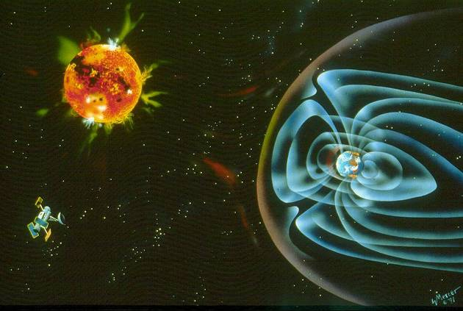
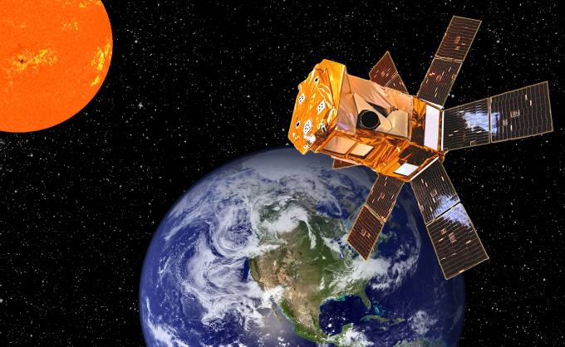
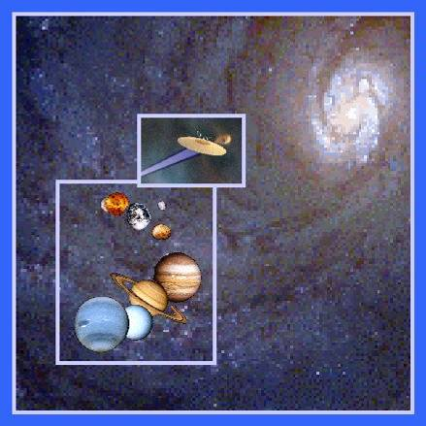
Space and Earth Science Research
LASP conducts theoretical and experimental research in…
Planetary Physics
Solar Terrestrial Physics
Atmospheric Sciences
Space Physics
LASP conducts theoretical and experimental research in….
Planetary Physics
Solar Terrestrial Physics
Atmospheric Sciences
Space Physics
LASP has successfully developed scientific instrumentation for…
12 Deep Space Missions
19 Earth Orbiting Missions
230 Suborbital Rocket Experiments

Slide 6
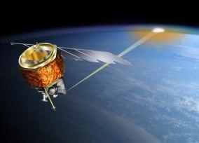
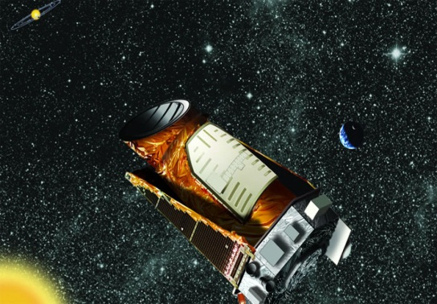
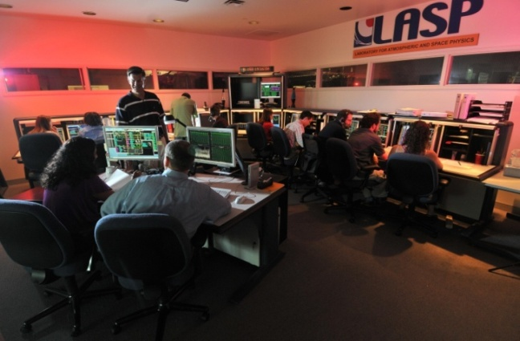
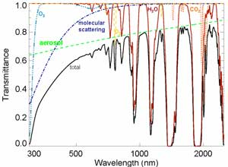
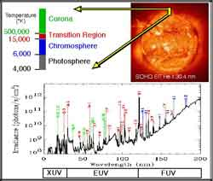
Operating $1B of Space Assets
Develop & Test New Systems
Operate Spacecraft & Payloads
Integrated Professional & Student Operators
Process & Distribute Data to Scientific Community and Beyond

