Slide 1

Comparing the relative stability of CERES, MISR and MODIS Radiances
Joseph Corbett and Norman Loeb
Thanks to:
Wenying Su, Dave Doelling, Costy Lukashin and Walt Miller
Terra Working Group Meeting Aug 26th 2014

Slide 2
Introduction
14 year record of Terra allows us to compare the long-term relative stability of the radiances from the different instruments.
We can use this to get a sense of the robustness of trends (or lack of trends as the case may be) in the reflected radiation.
CERES, MISR and MODIS all have independent calibration techniques so comparing them is a good test of each instruments calibration.
We use the Single Scanner Footprint - MISR (SSFM) dataset.
  Combines CERES, MODIS and MISR radiances and scene information into a single dataset.
Notes:
IN order to have confidence in the trends of reflected radiation, or the physical characteristics derived from them we need to have confidence that our radiances aren’t changing due to calibration changes over the time period. One way to examine this is to compare the radiance's from different datasets.
With a 14 year record we are able to determine the long term relative stability of the the radiances measured by the MISR, MODIS and CERES.
The instruments all use different calibration techniques, so this is an independent test of the calibration from the different instruments.
The dataset we are using is the Single Scanner footprint MISR dataset. This combines the CERES, MODIS and MISR radiance information into one dataset.

Slide 3
SSFM Dataset
Takes the existing SSF dataset - CERES radiance, flux and MODIS radiances, CERES team cloud information and adds the MISR radiances from the different angles.
Narrowband radiances consist of the 4 MISR bands (446, 557, 672 and 868 nm) and 2 MODIS bands (650 and 858 nm )
Narrowband radiances are matched in time and space and averaged over the CERES footprint using the CERES point spread function.
We have extended it from March 2000 to February 2014 using the CERES FM1 Edition 3A, MODIS Collections 4 and 5 and MISR Level1 Ellipsoid F03_0024 datasets.
Processed every 16th day of data in order to get the orbit repeat cycle but limit the processing time and dataset size.
This version is limited to CERES cross track viewing angles of <5°.
Notes:
So a bit more about the dataset.
This dataset has existed for a while now, essentially it is the standard CERES footprint level dataset, known as the SSF, or single scanner footprint which contains radiance, flux, cloud and scene type information.
To create the data set, we match the narrowband radiance pixels in space and time with the CERES field of view, the relevent pixels are than combinedi n a weighted average using the CERES point spread function.
This dataset was originally processed using CERES in along track scanning mode which was only performed twice a month from 2000-2005. In order to extend it we have used the CERES in cross-track mode which allows us to use the full 14 year record.
We have used only CERES edition 3A and the FM1 instrument only. For MODIS the CERES edition 3A SSF uses collections 4 and 5 and we use the level1 ellipsoid radiances from MISR, edition f03_0024.
We do two things in order to improve the processing time when developing this dataset. One was to limit the CERES viewing zenith angle to be less than 5 degrees. The second was to process only every 16th day of data. We did this in order to capture the repeat cycle and get good sampling of the same locations over time.

Slide 4
Notes:
This is what the spatial sampling looks like for 2013. You can see each of the 14 paths that occur for this data day (data day 11) I’ll just note here that I am using “data years”, so one year consists of all the data we processed from March of that year through February of the following year – giving us the same temporal sampling for each year.
The sampling is pretty good, a high number of counts per each lat lon box for most of the globe, and each of the orbit paths is equally well sampled.

Slide 5
Notes:
For the purposes of this study we are going to limit the scene types we consider to be ocean scenes, from 45N to 45S. We do this because we want to look at scenes where the visible bands we are using are the most representative of the broadband from CERES. This is because we want to limit the noise between the narrowband and broadband, but also because we want any changes in the relationship to not be due to changes in the spectral characteristics of the the scene type.

Slide 6
Notes:
This is the temporal sampling for each data year for the limited sampling region we are using.
For the most part each year has around 600000 data points, the notable exceptions been 2000, 2001 and 2005

Slide 7
FM1 stowed Jan, Feb, Mar 2006
FM1 in RAPS mode
Notes:
For 2000 and 2001 this is because the FM1 instrument was operated in rotating-azimuth plane mode for part of each year, reducing the number of samples in cross-track. Because this is not a random error, but rather systematic we are actually not going to use 2000 and 2001 in the analysis as they introduce spuruious trends.
For 2005, FM1 was stowed for Jan and Feb of 2006, which is part of the 2005 data year.

Slide 8
Method
Average the ‘y’ and ‘x’ radiance in 5 Wm⁻²sr⁻¹ (3 Wm⁻²sr⁻¹ if ‘x’ is a NIR band) bins of the ‘x’ radiance → µ_{x}, µ_{y}
Perform linear regressions between µ_{x} and µ_{y} for each year.
Use that to estimate a ‘Y’ radiance as a function of the µ_{x} radiance.
Repeat using the regression coefficients from the reference year (2002).
Calculate the mean relative bias → (Y - Y₂₀₀₂)/Y₂₀₀₂.
Tells us how the ‘y’ radiance has changed with respect to the ‘x’ radiance over time.
A positive bias indicates increase in the ’y’ radiance relative to the ‘x’ radiance and negative bias indicates a decrease in the ’y’ radiance relative to the ‘x’ radiance.
Important to note that as these are relative biases we can’t use them to say which instrument is the more stable.
Notes:
To examine the relationship between any two of the radiances we are using a regression relationship. Initially we average the x and y radiances into 5 w/m2 bins in the x radiance. We do this to reduce the effect changes in scene-type distribution might be having on the relationship.
The next step is to perform a regression using the y means and the x means, and use that to estimate t Y radiances as a function of the mean x radiances.
We do this for each year, and for each year calculate an estimate of the Y radiances using regression coefficients from our reference year and then calculate the bias between the estimates. The bias is calculated as the mean of the relative biases.
A positive bias indicates that the y radiance has increased relative to the x radiance since 2002, and a negative bias indicates that the y radiance has decreased relative to the x radiance since 2002.
It is really important to note that we are looking at relative biases, so all we can say is how they have changed relative to one another, not weather one is more stable than the other. Really stressing that point as I don’t want ot get shouted out of the room.

Slide 9
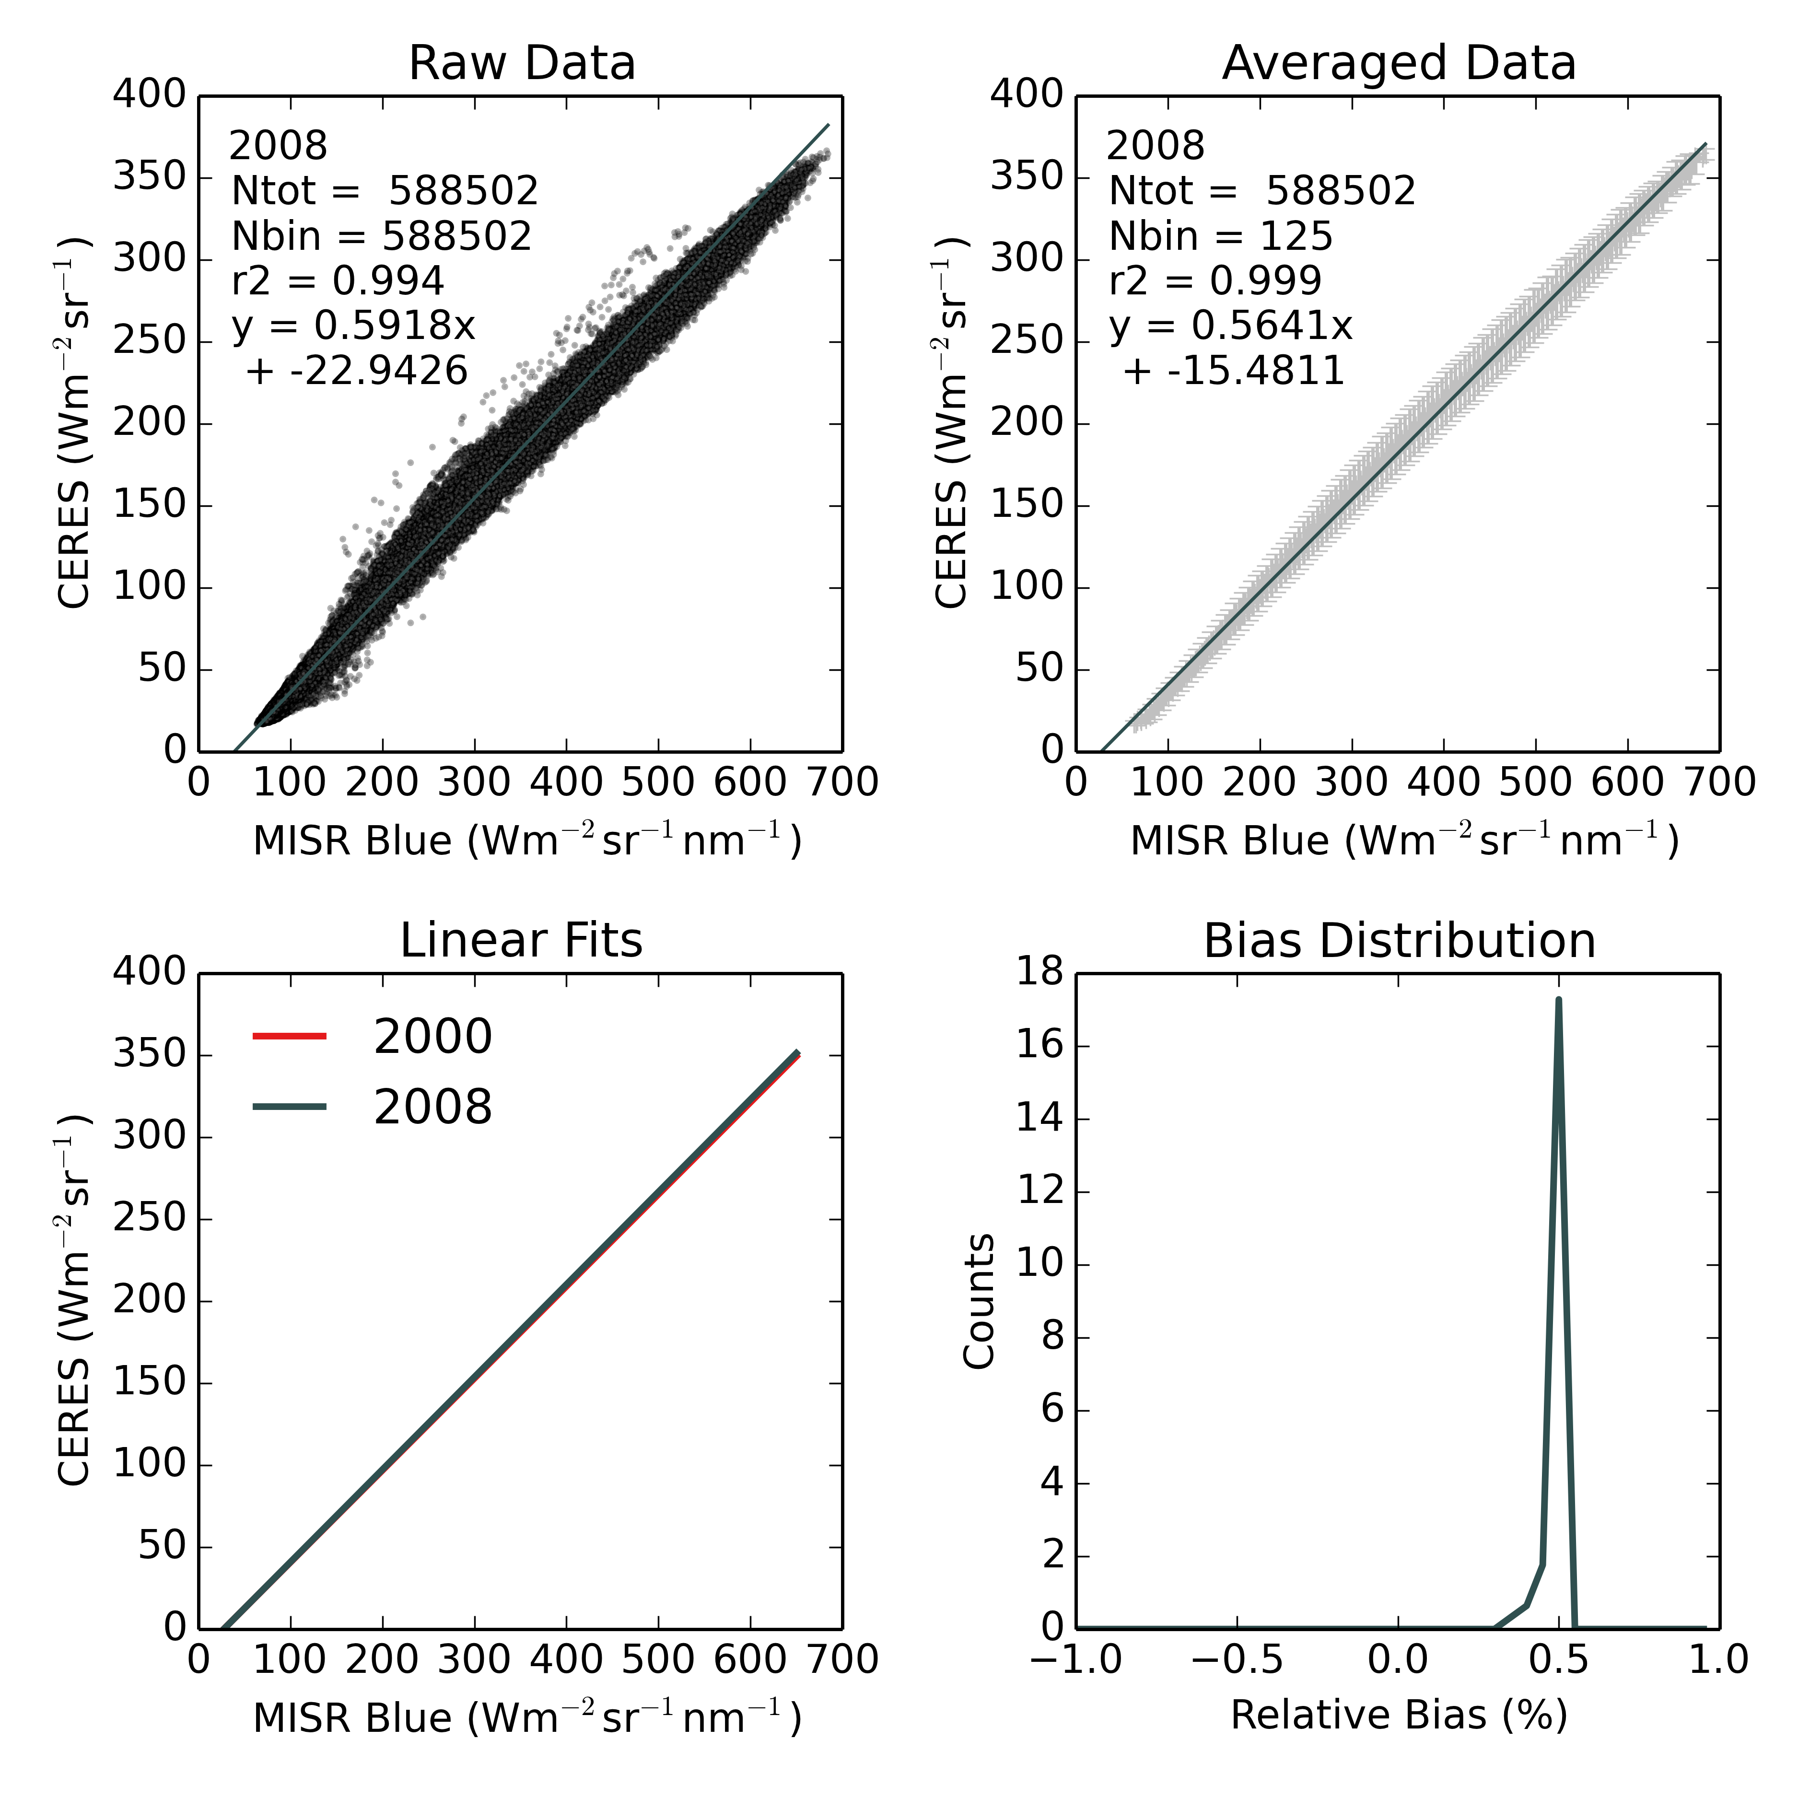
Notes:
This is just a graphical look at the method we are using – the first plot shows the raw data when we are comparing CERES (on the y axis) with the MISR blue band (on the x). The raw data is shown on the top left, as you can see the relationship is very good, with an r-squared value of 0.994.
The upper right plot shows the relationship when we average the radiances in 5 w/m2 bins. The grey bars indicate the 2 standard deviation range. The coreraltion is even better here, but note that we haven’t changed the relationship too much. And the slopes are similar.
The lower left plot compares the fit from 2002 in red with the fit from 2008. They are clearly very similar and its quite hard to distinguish the two.
The final plot shows the distribution of relative biases between estimated y values using coeffeicinets from 2002 and 2008. The distribution is very tight and the mean bias is only in the vicinity of 0.5%.

Slide 10
Notes:
The first set of comparisons we are looking at is CERES vs MISR. For this comparison we have CERES as the y radiance and MISR as the x radiance. The yearly values are plotted as squares, with the linear trend shown as the solid line. And the per decade trends shown in down here.
The main feature is the consistent linear trends between the MISR green, red and NIR bands and the CERES radiance. The per decade trends are less than or equal to 1% per decade. But they are consistent, which suggests the trends are real and not just the result of the method or noise. The year to year variations are similar between the bands, especially for the red, green and nir bands.
The blue bad is noticeably different with a trend that is not significant from zero. It is characterised by a large change between 2008 and 2009. This might be a calibration change in MISR? The green band also appears to change .
Overall though the trends are quite small, 1% per decade is

Slide 11
Notes:
This comparison is showing the relative change between CERES and MODIS. The same way, with CERES as the y radiance. The trends for the MODIS-CERES comparison are much larger than the MISR trends. However there is a larger step change in biases around 2008. This corresponds to a documented change in the calibration of MODIS of around 1.5%. If you ignore then the trends are much lower, especially for the NIR band which looks like it would be flat if not for the jump.

Slide 12
Notes:
This is what we get when we compare the MISR bands to each other. The trends between the green, red and nir bands are close to zero. This is consistent with the CERES misr comparison.
The trends between the blue band and the remaining band is positive and close to 1% per decade, but again there appears to be a jump around 2008-2009 which may be contributing the trend.

Slide 13
Notes:
This is the comparison between Misr and MODIS brown and pink and between MODIS and MODIS in dark green.
Looking at the misr/modis comparison we see large jump in 2009 and after that it is relatively flat. There is a drop in the NIR comparison between 2006 and 2008, which I’m not sure anout.
There is a decrease between the MODIS bands, howerver it is fairly noisy and appears to have flattened off from 2010.

Slide 14
Conclusions
Combining the CERES, MISR and MODIS products gives us a unique dataset that we can use to examine the relative stability of the instruments over time.
Overall the trends in the relative drift between the CERES, MISR and MODIS radiances are low, less than 2.3 %/decade
And except for MODIS they are less than 1%/decade
The larger drifts between MODIS and CERES/MISR are mainly due to documented step changes in the calibration.

Slide 15
Notes:
This is showing what the fits and averaged data look like for 12 years. The correlations are high for all years, close to 0.999 and the slopes are changing very slightly over the 12 years. This suggests that the relationship is quite stable over the years and that the relationship is not changing significantly.

