Slide 1
ASTER Science Highlights from Japan/US ASTER Science Team
Michael Abrams, JPL

Slide 2
OUTLINE
Glaciology
ASTER GlobalDEM
Global Urban Extent
Global Emissivity Data Base
ASTER Geoscience products
ASTER Volcano Archive (AVA)

Slide 3
GLACIOLOGY
GLIMS book published. Dr. Kargel (AST Member), co-editor and major contributor. Majority of data used is from ASTER. Also Landsat

Slide 4
GLACIOLOGY
Randolph Glacier Inventory recently published. Images come from GLIMS database (PI Dr. Jeff Kargel, ASTER Science Team Member) and ASTER images
National Center for Atmospheric Research Staff (Eds). Last modified 20 Aug 2013. "The Climate Data Guide: Randolph Glacier Inventory data base of global glacier outlines." Retrieved from https://climatedataguide.ucar.edu/climate-data/randolph-glacier-inventory-data-base-global-glacier-outlines.

Slide 5
The Juneau Icefield:
Using ASTER imagery and DEMs to produce velocity and surface elevation change rate maps published in Journal of Glaciology, 2014
Andrew K. Melkonian¹
Michael J. Willis^{1,2}
Matthew E. Pritchard¹
1, Earth and Atmospheric Sciences Department, Cornell University; 2, Geological Sciences, University of North Carolina at Chapel Hill

Slide 6
Surface Elevation Change Rates (dh/dt)
ASTER DEMs, along with a reliable reference DEM (in this case the SRTM DEM), provide spatially comprehensive, high-resolution maps of dh/dt
Weighted linear regression applied to elevations on a pixel-by-pixel basis
These results span 2000-2009/2013, give average mass balance of -0.13±0.12 m w.e. a^{–1}

Slide 7
Glacier Velocities
Pixel-tracking applied to ASTER image pairs produces good velocities where ice, crevasses are expose (usually at lower elevations)
Higher elevations are noisy due to uniform cover such as snow, clouds that prevent successful pixel-tracking
These results are from 48 ASTER pairs spanning 2001/08 to 2010/06

Slide 8
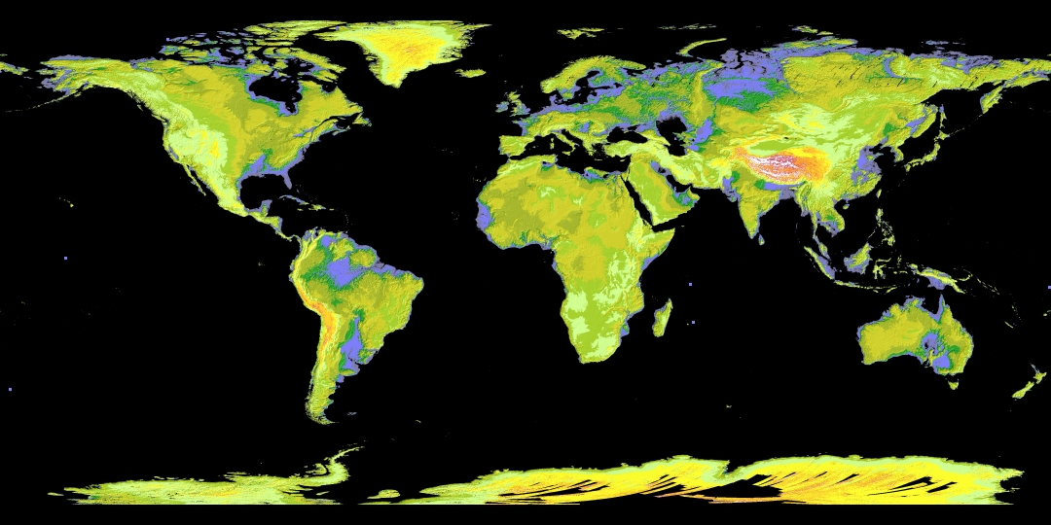
ASTER Global Digital Elevation Model (GDEM)
Only high resolution, global DEM freely available to all users. 83N to 83S, 30m postings. Over 28 million 1x1 degree tiles downloaded since June 2009

Slide 9
Global DEM
Sochi 2014 Winter Olympics and Pakistan earthquake
Global DEM
Gaps filled in with SRTM and other DEMs

Slide 10
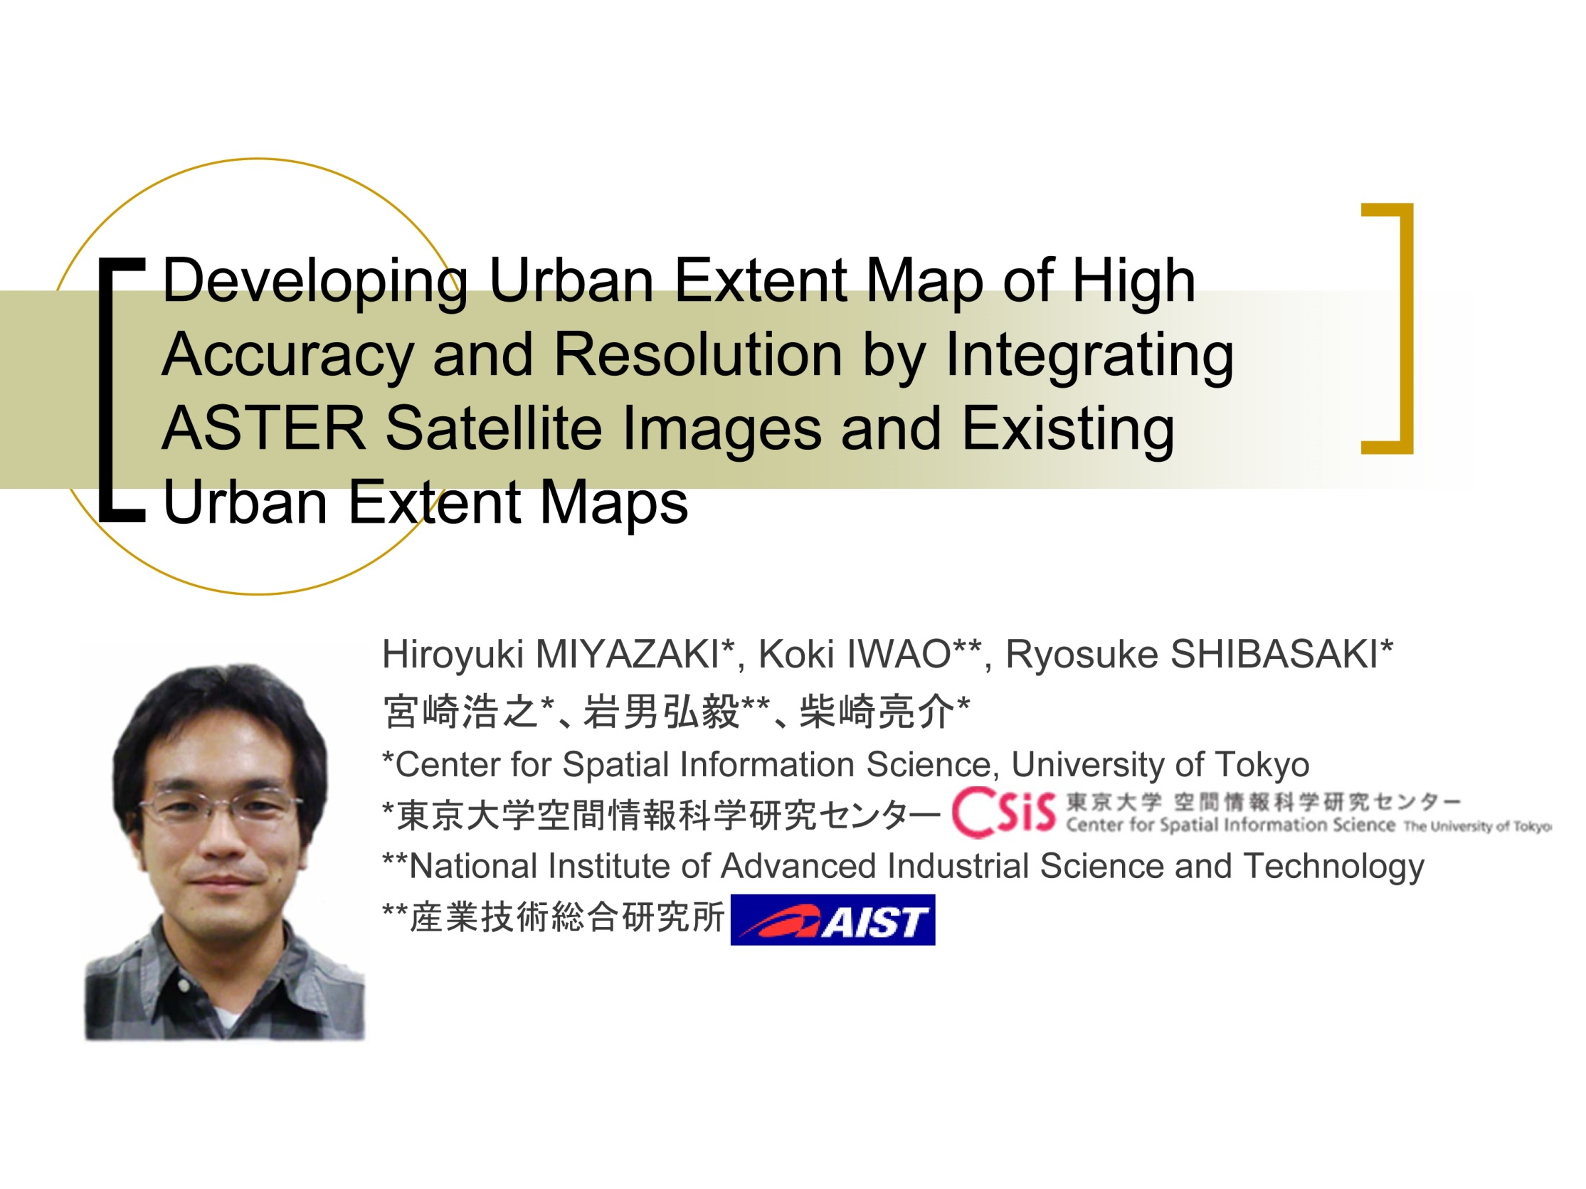

Slide 11
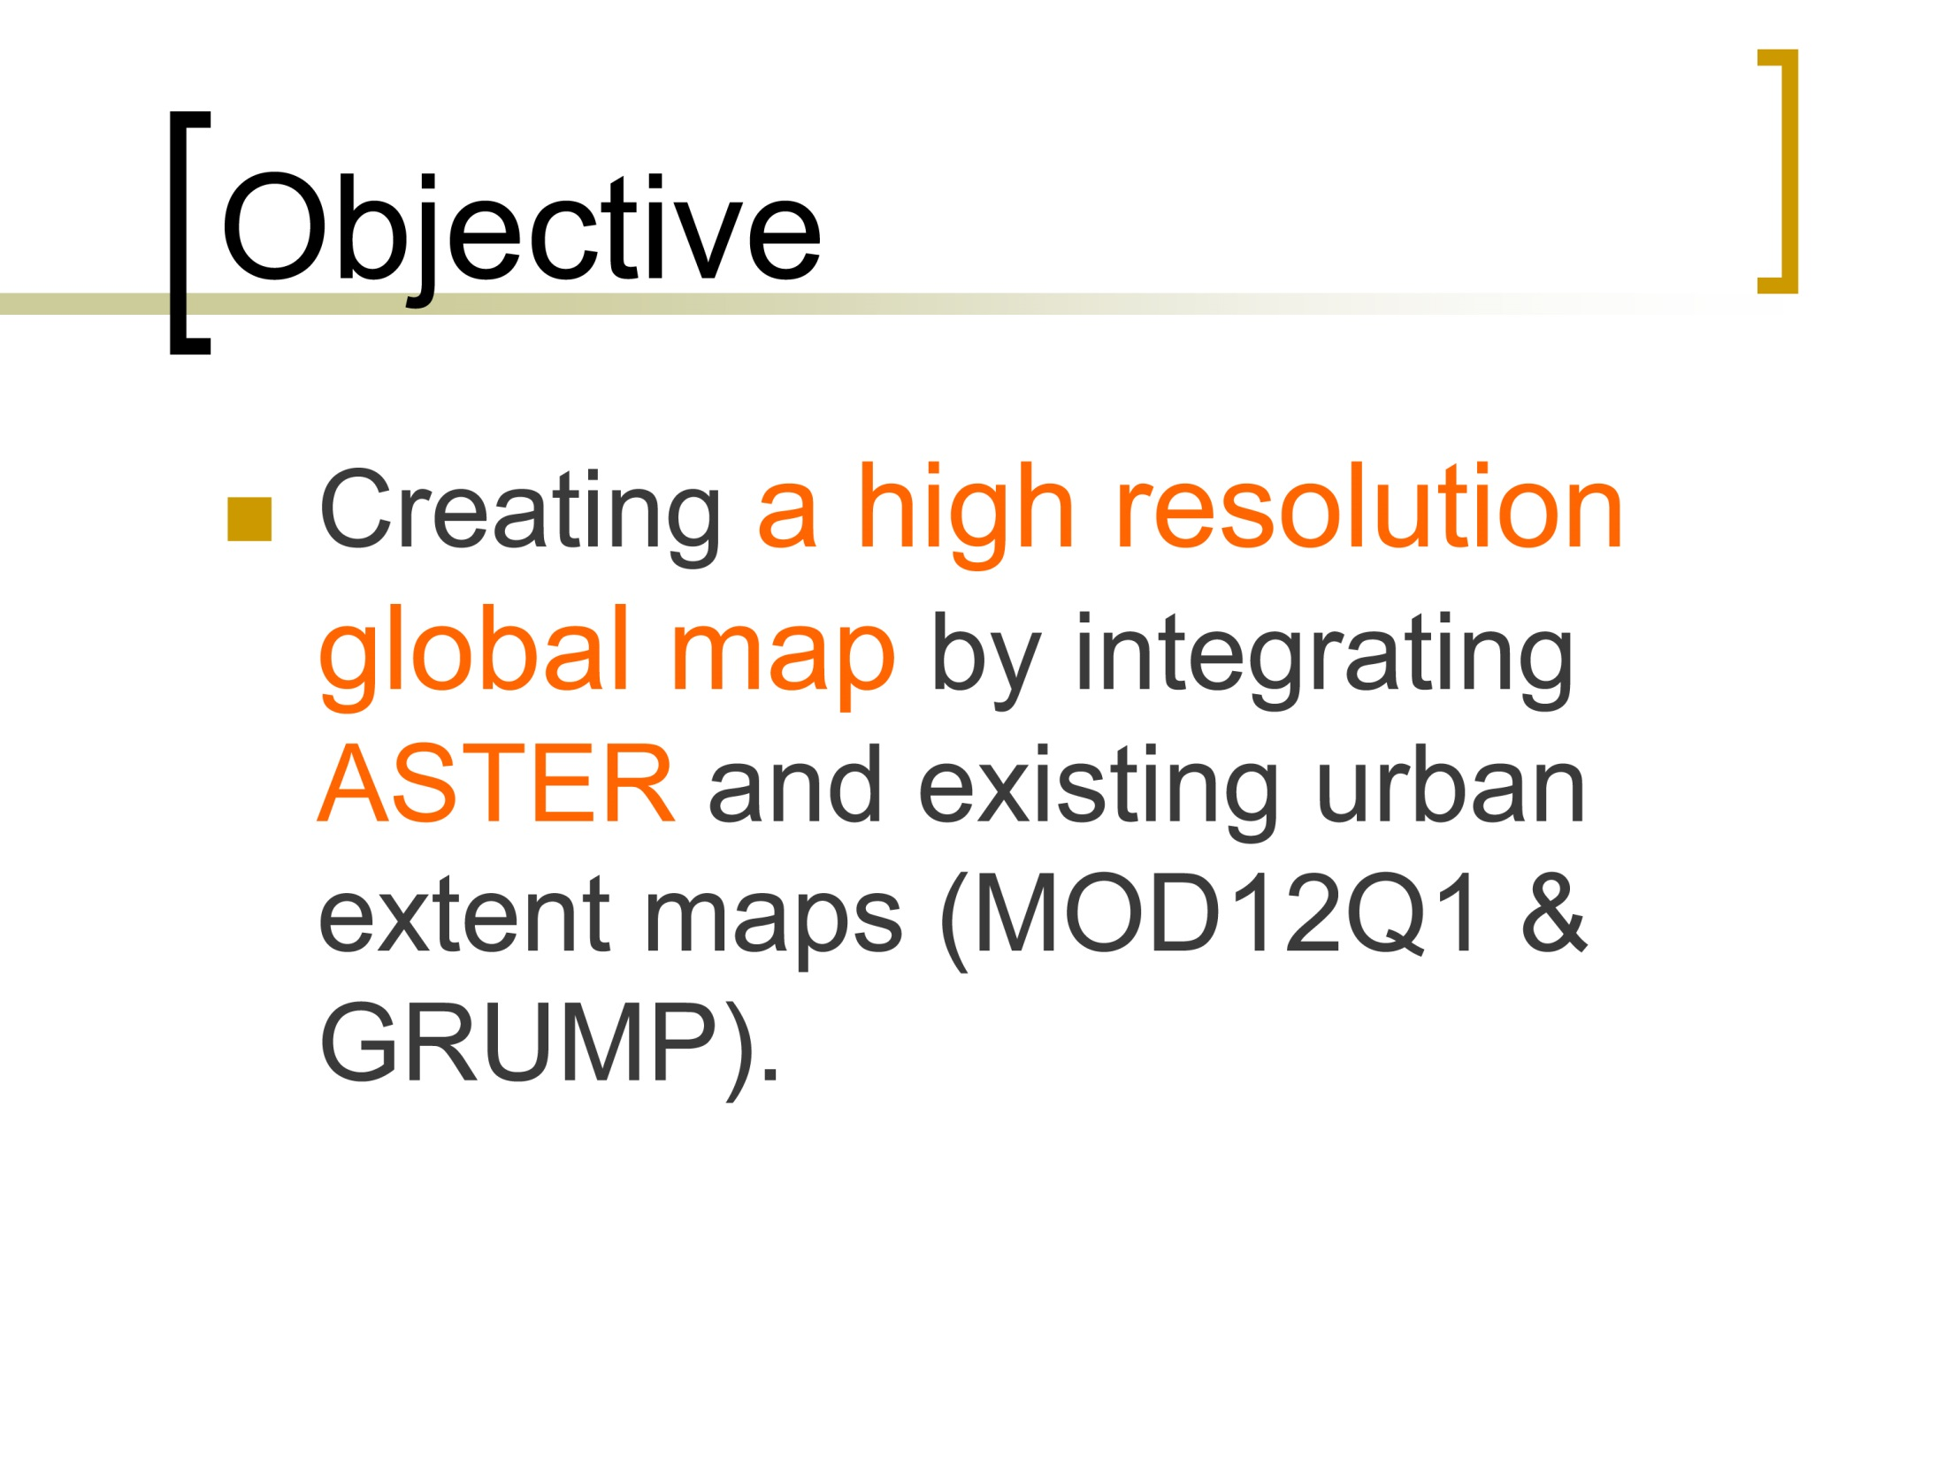

Slide 12
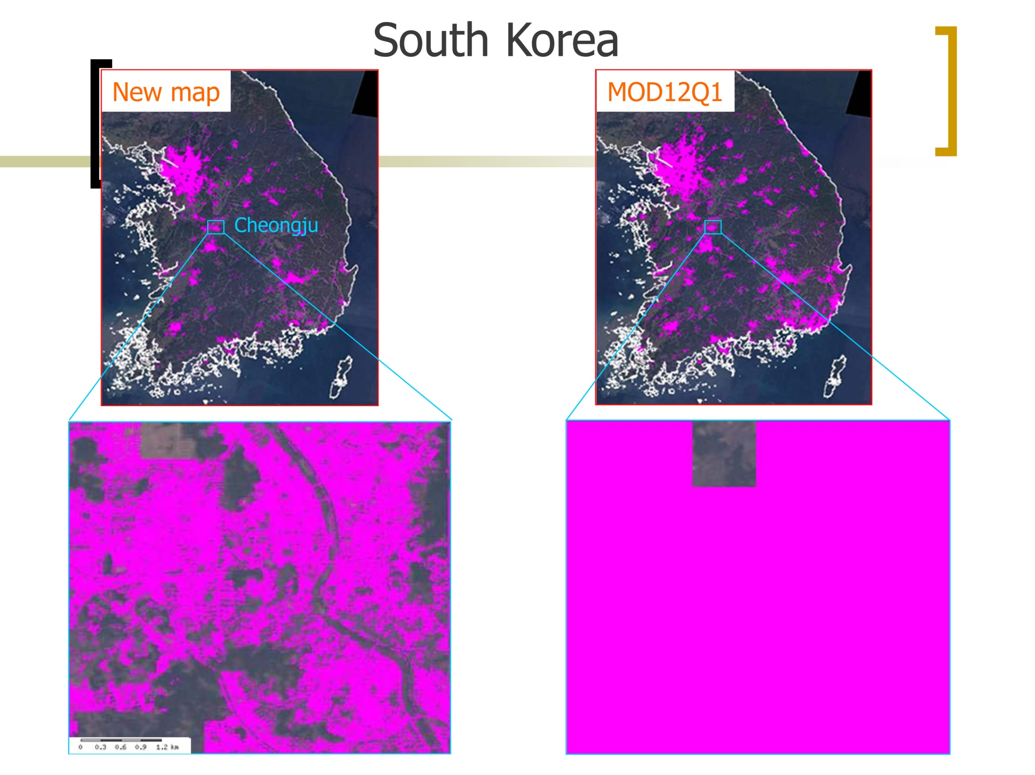

Slide 13
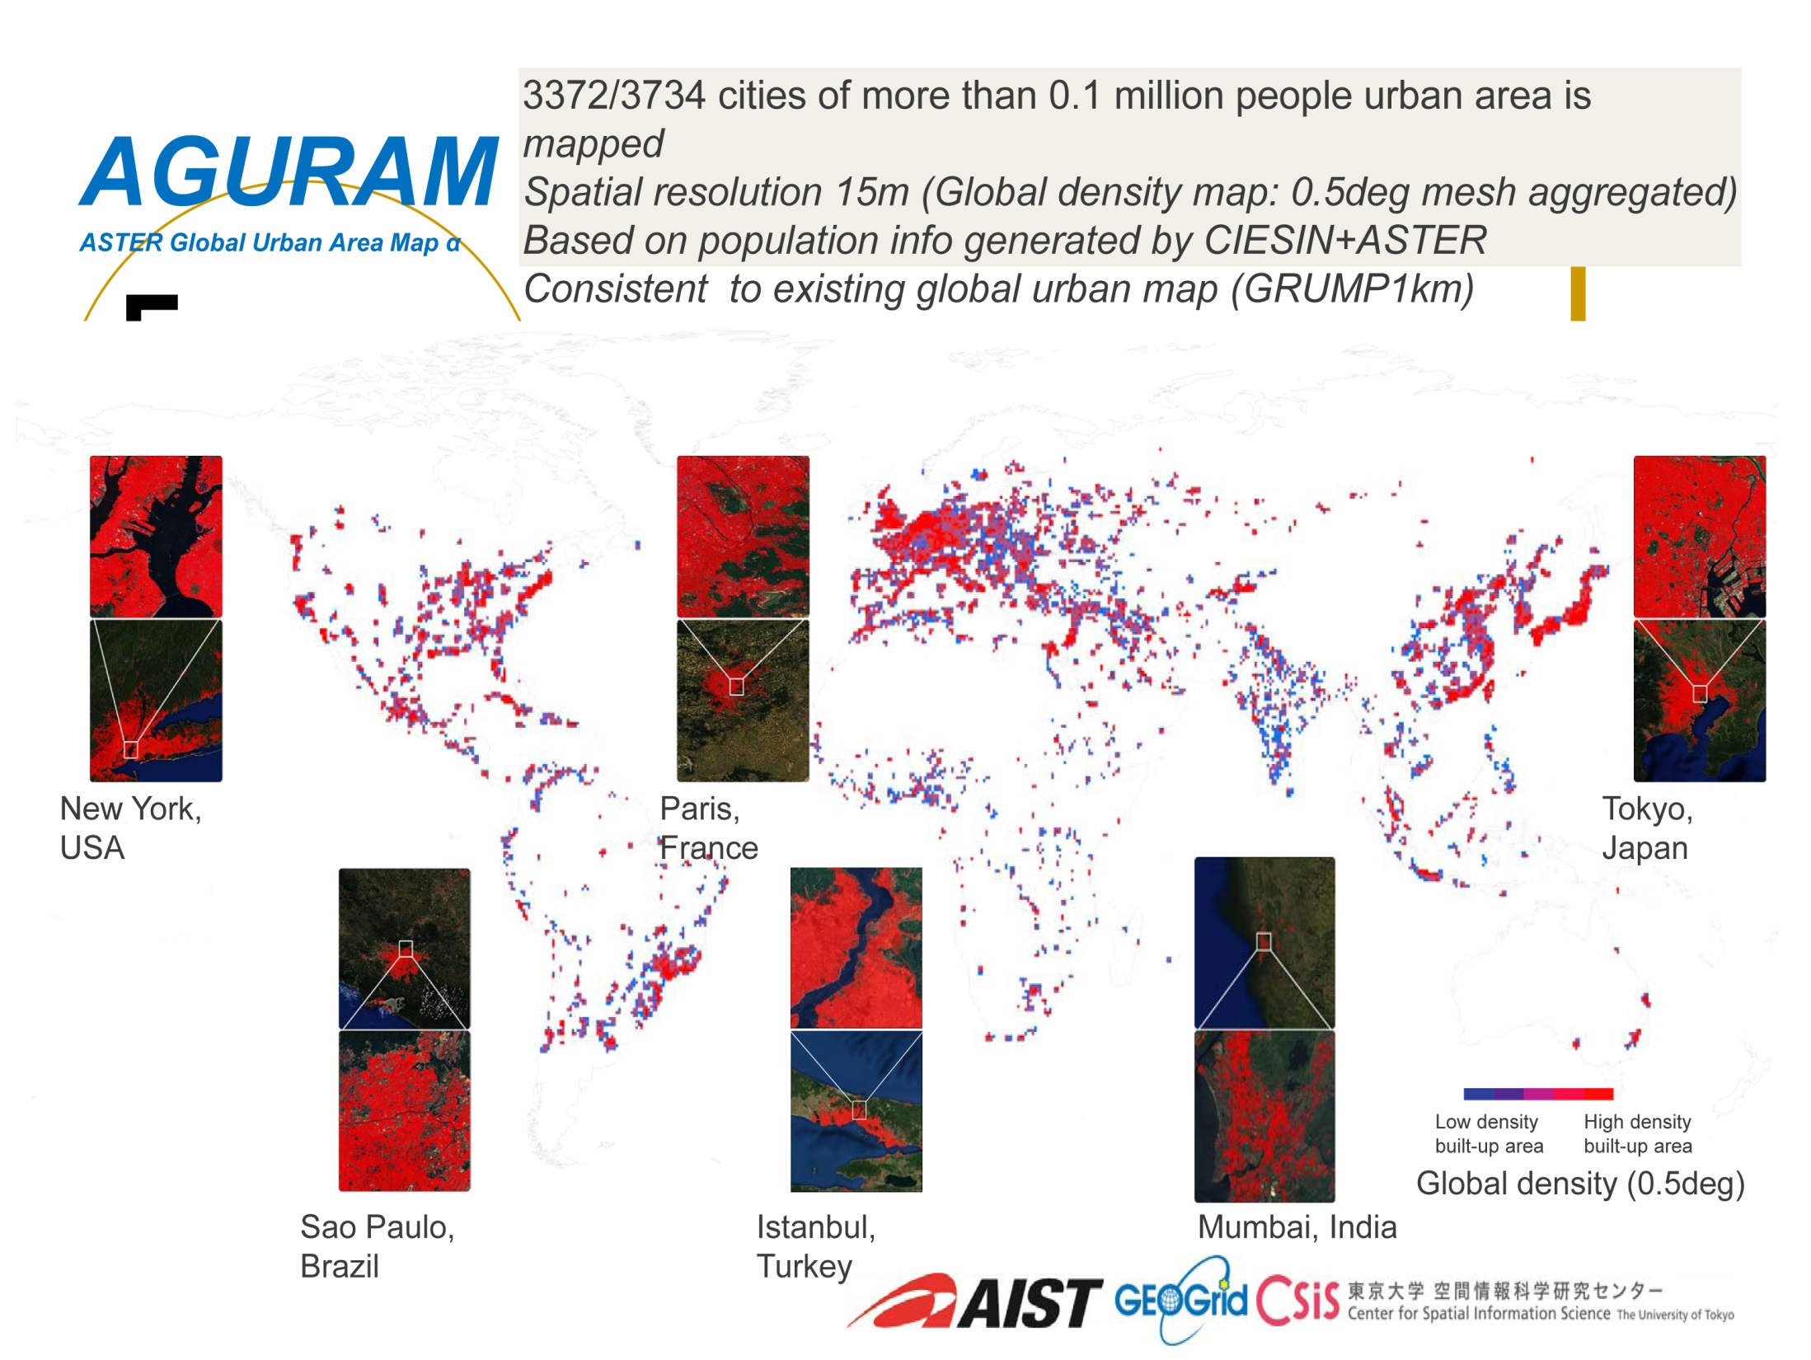

Slide 14
ASTER Global Emissivity Database (GED)
Created by Glynn Hulley, JPL
Produced from entire ASTER TIR archive; 5 emissivity channels + T_{ave}.
100m spatial resolution; available as 1x1 degree tiles for entire dataset

Slide 15
ASTER Global Emissivity Database (GED)
The same algorithm is now used to
produce MOD21 data product. GED is used by AIRS and TES

Slide 16
Australian ASTER Geoscience Data Products
17 National geoscience GIS-compatible maps; scalable, digital, “measured”.
Created from thousands of ASTER scenes.
New mineral discoveries and environmental applications are a direct result.

Slide 17
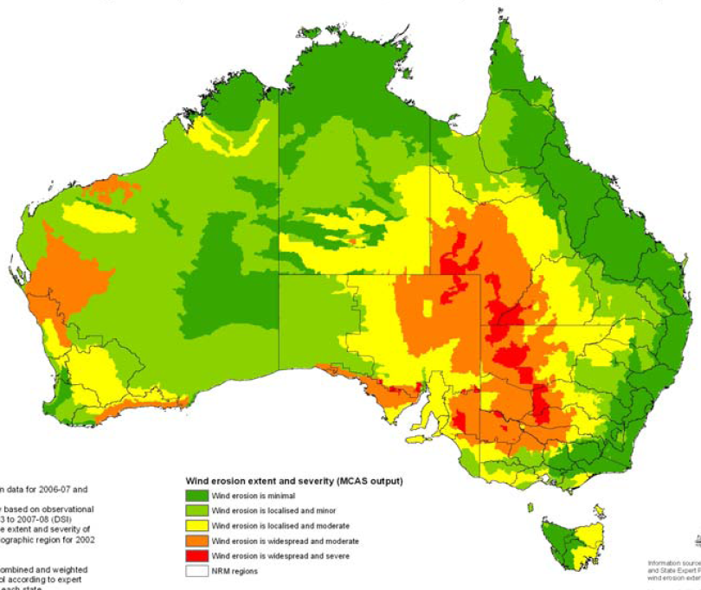
Wind erosion risk and severity map
BoM dust activity
Chemsys model
Expert information
Smith and Leys, 2009

Slide 18
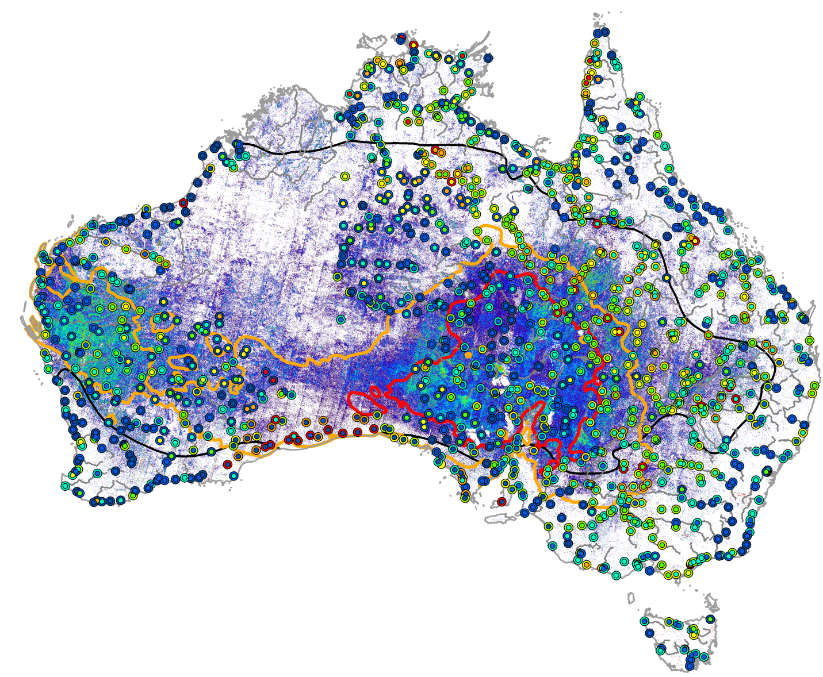
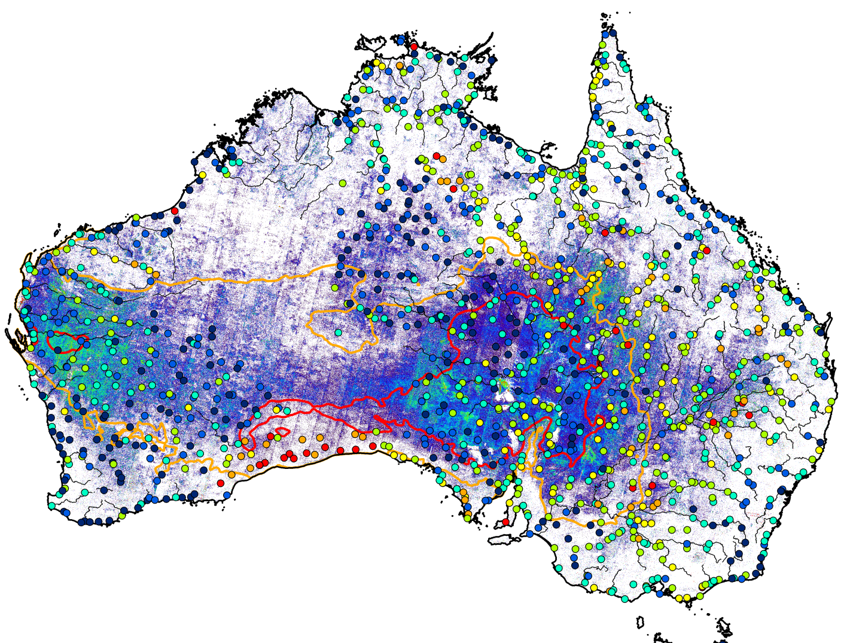
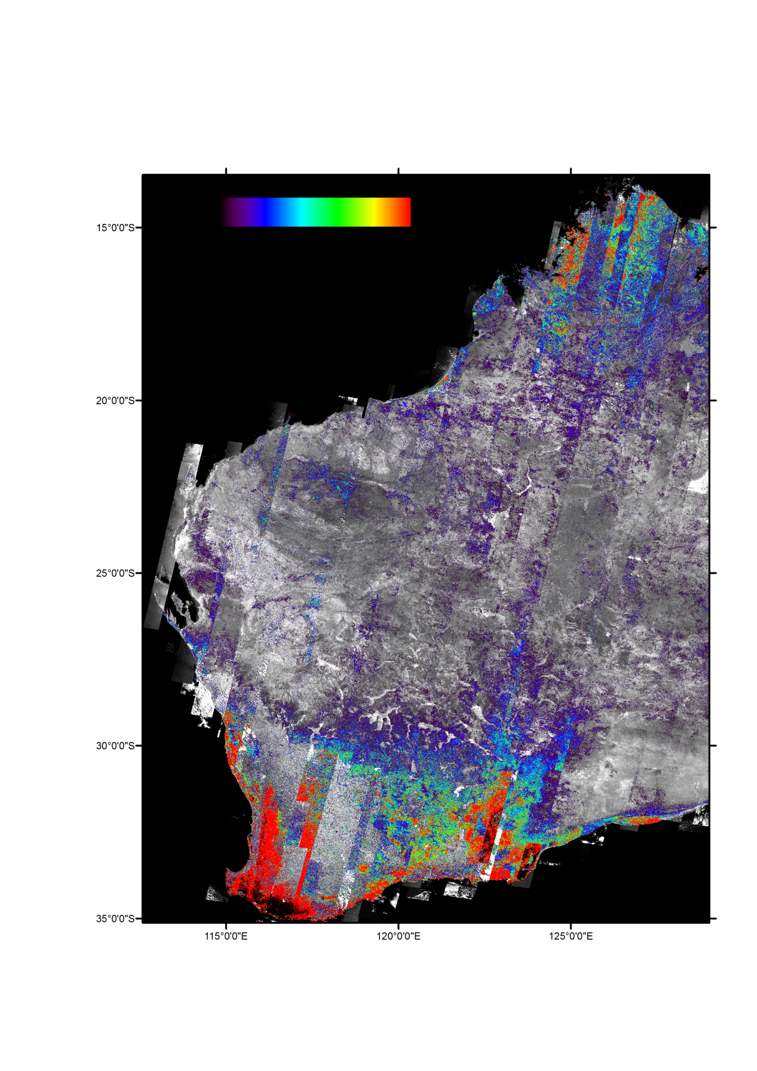
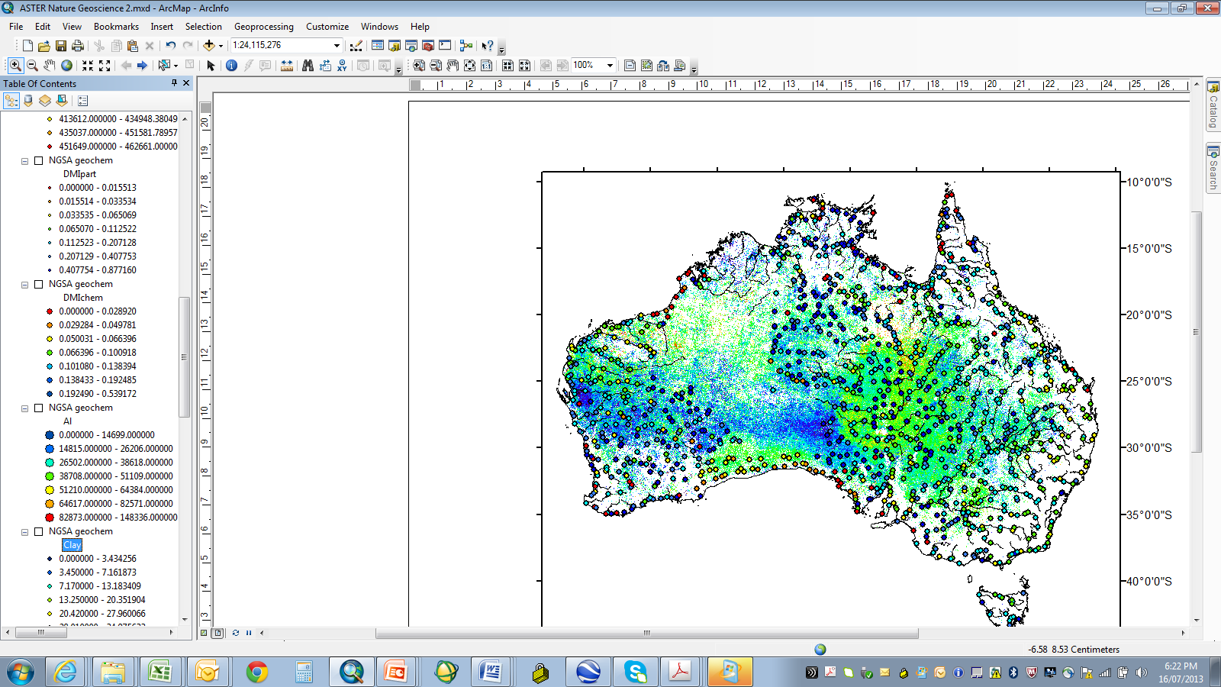
ASTER Al-clay content
low high
% clay
Al/(Al+Ca+Mg+K+Na)
0.0-3.5
3.5-7.2
7.2-13.2
13.2-20.4
20.4-28.0
28.0-35.0
35.0-56.0
0.00-0.41
0.41-0.62
0.62-0.70
0.70-0.78
0.78-0.85
0.85-0.92
0.92-0.99
annual rainfall (mm)
200
300
limit of arid zone

Slide 19
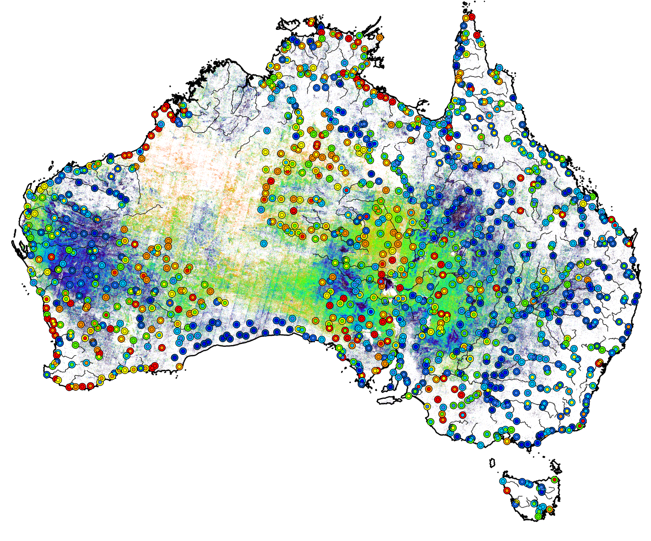
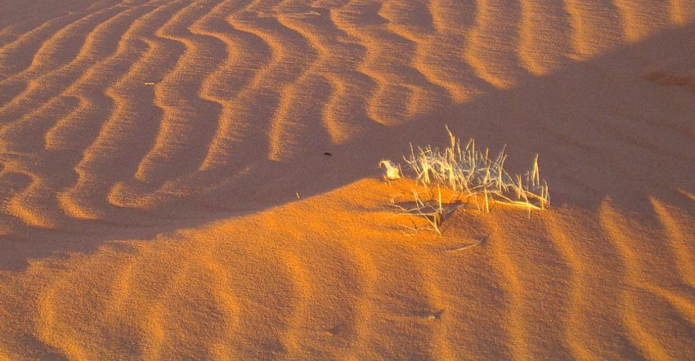
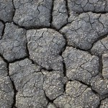
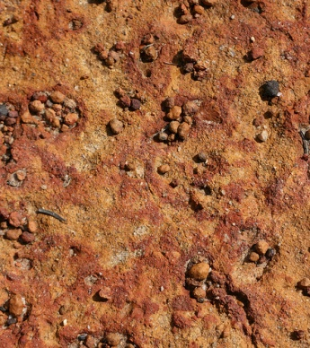
wind
deposition
(E_{d})
wind
erosion
(E_{e})
water
deposition
(A_{d})
water
erosion
(A_{e})
ASTER sand-clay index (SCI)
0 (clay) 1 (quartz sand)
weathering and soil formation (W_{s})
clay soil
E_{e} > E_{d} + A_{d} + W_{s} > A_{e}
then quartz sand
A_{e} > E_{d} + A_{d} + W_{s} > E_{e}
then fresh rock or hardpan
sand/(sand+clay)
Si/(Si+Al)
0.000-0.015
0.015-0.033
0.033-0.065
0.065-0.112
0.112-0.207
0.207-0.408
0.408-0.877
0.000-0.029
0.029-0.050
0.050-0.066
0.066-0.101
0.101-0.138
0.138-0.192
0.192-0.540

Slide 20
VOLCANOLOGY
ASTER Volcano Archive, created by David Pieri, JPL
All ASTER and (soon) Landsat images for >1500 active volcanoes
Includes thermal anomaly analyses, DEMs, ash advisories

Slide 21
VOLCANOLOGY
ASTER Volcano Archive, created by David Pieri, JPL
All ASTER and Landsat images for >1500 active volcanoes
Fully Google Earth compatible

Slide 22
ASTER Follow-on??
Activities at JPL

Slide 23
Japan has no plans for ASTER follow-on. Commercialization with high resolution visible data is their model. Hyperspectral VSWIR instrument is stalled
JPL emphasis is on multi-(hyper-) spectral Thermal Infrared
Decadal Survey HyspIRI instrument… (Tier 2): Hyperspectral VSWIR+multispectral TIR. No Phase A date. Instrument designs, science goals studies funded; JPL is leader.
HyTES hyperspectral aircraft scanner is flying
Laboratory MS TIR instrument developed and functioning
ECOSTRESS EVI selected; MS TIR on space station
Discussions with non-US space agencies ongoing

